Slide 1
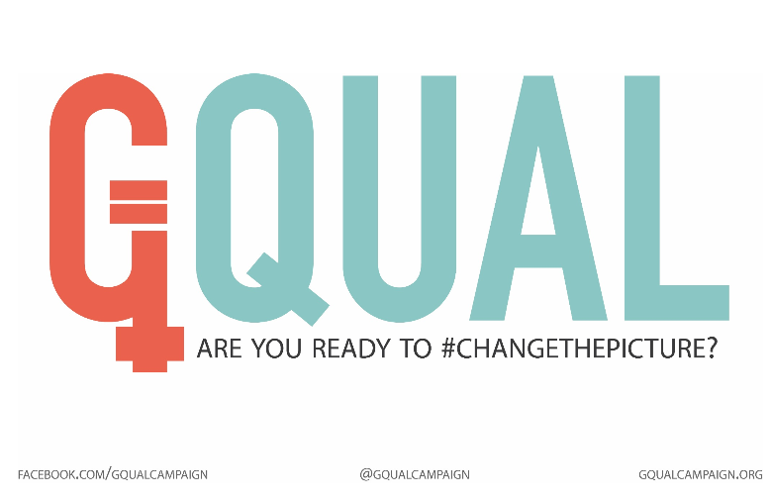

Slide 2
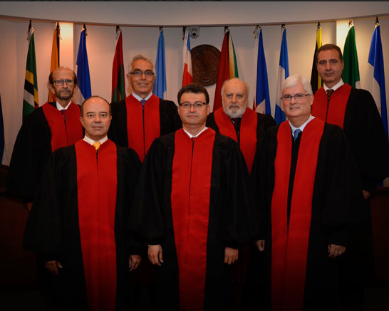


Slide 3
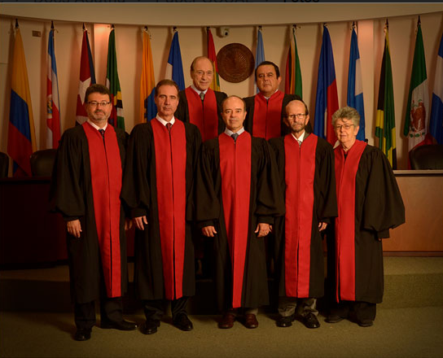

Slide 4
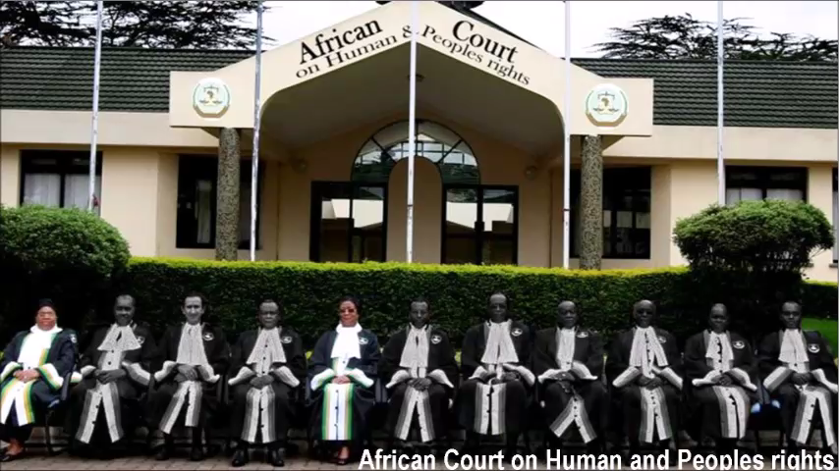

Slide 5
GQUAL MONITORS
91 International Bodies
599 available positions
Women occupy 199 of these positions (or 33%)
HOWEVER
If we take out CEDAW, the U.N. Working Group on Discrimination against Women in Law and Practice, the ASEAN Commission on the Promotion on the Rights of Women and Children, and the Committee on the Rights of the Child the number drops to 24%

Slide 6
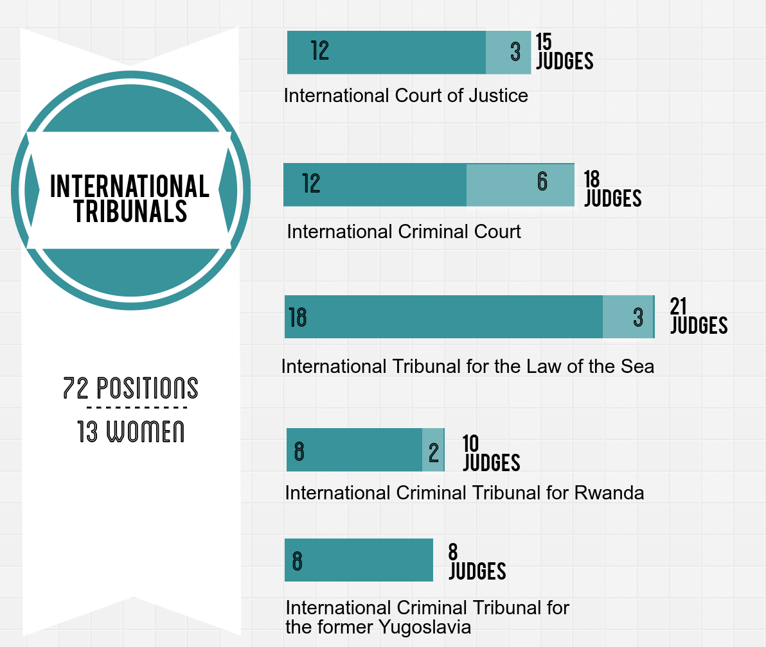
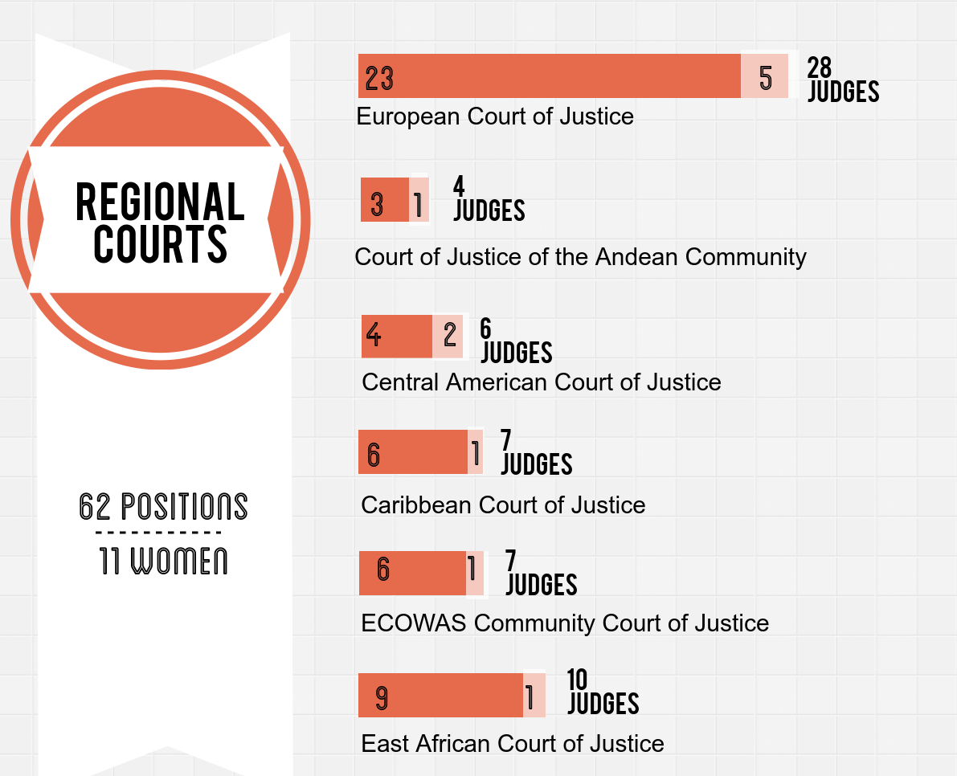
CURRENT COMPOSITION

Slide 7
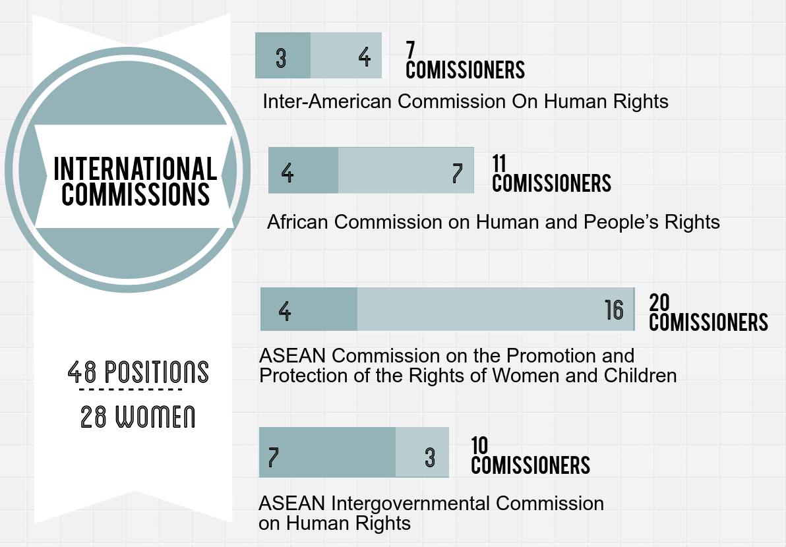
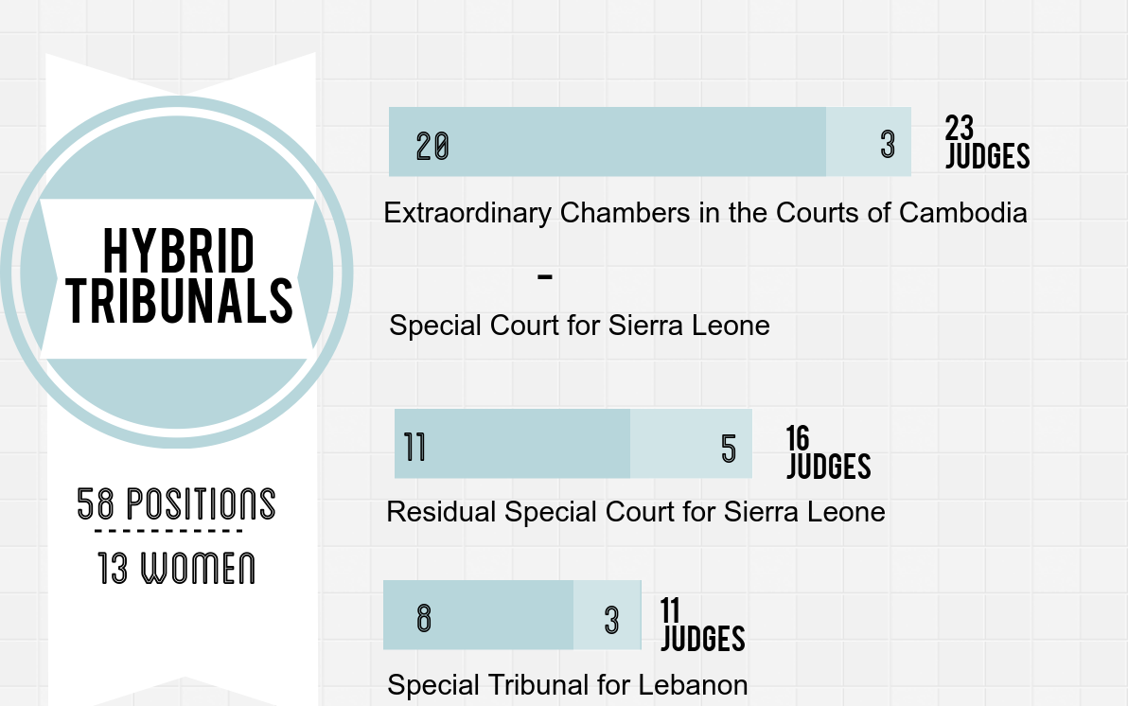

Slide 8
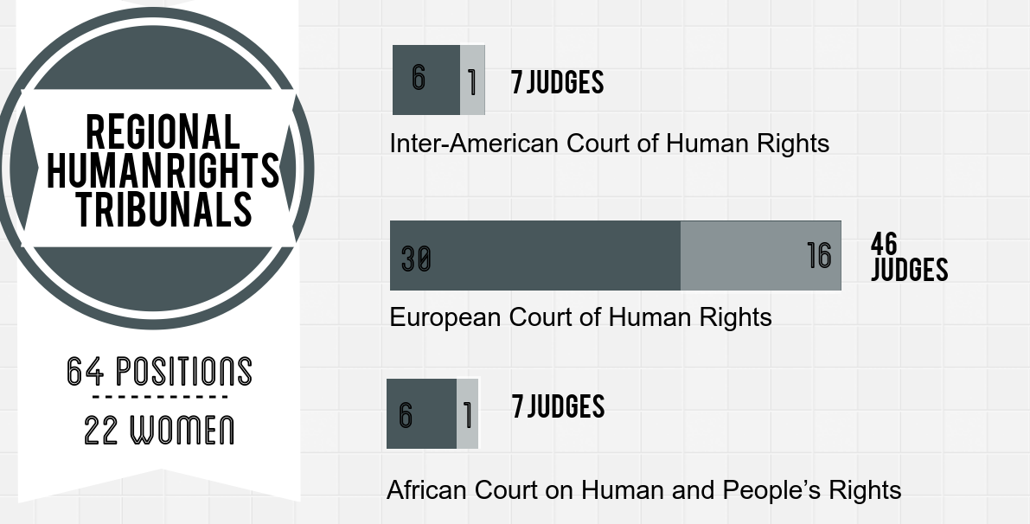

Slide 9
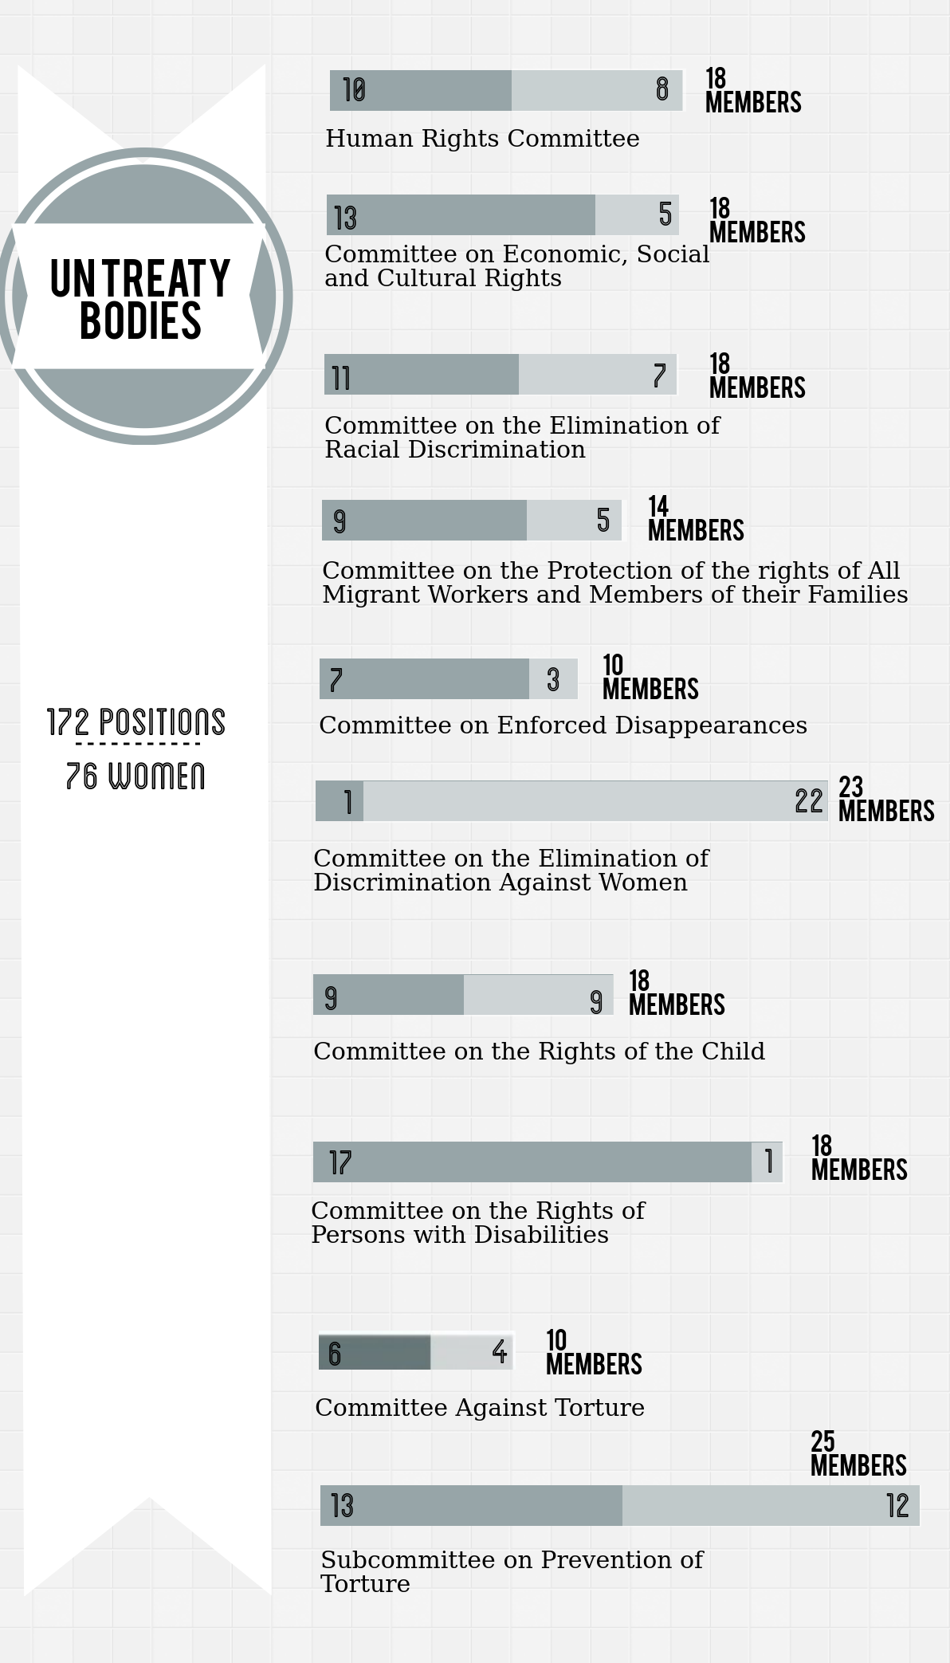

Slide 10
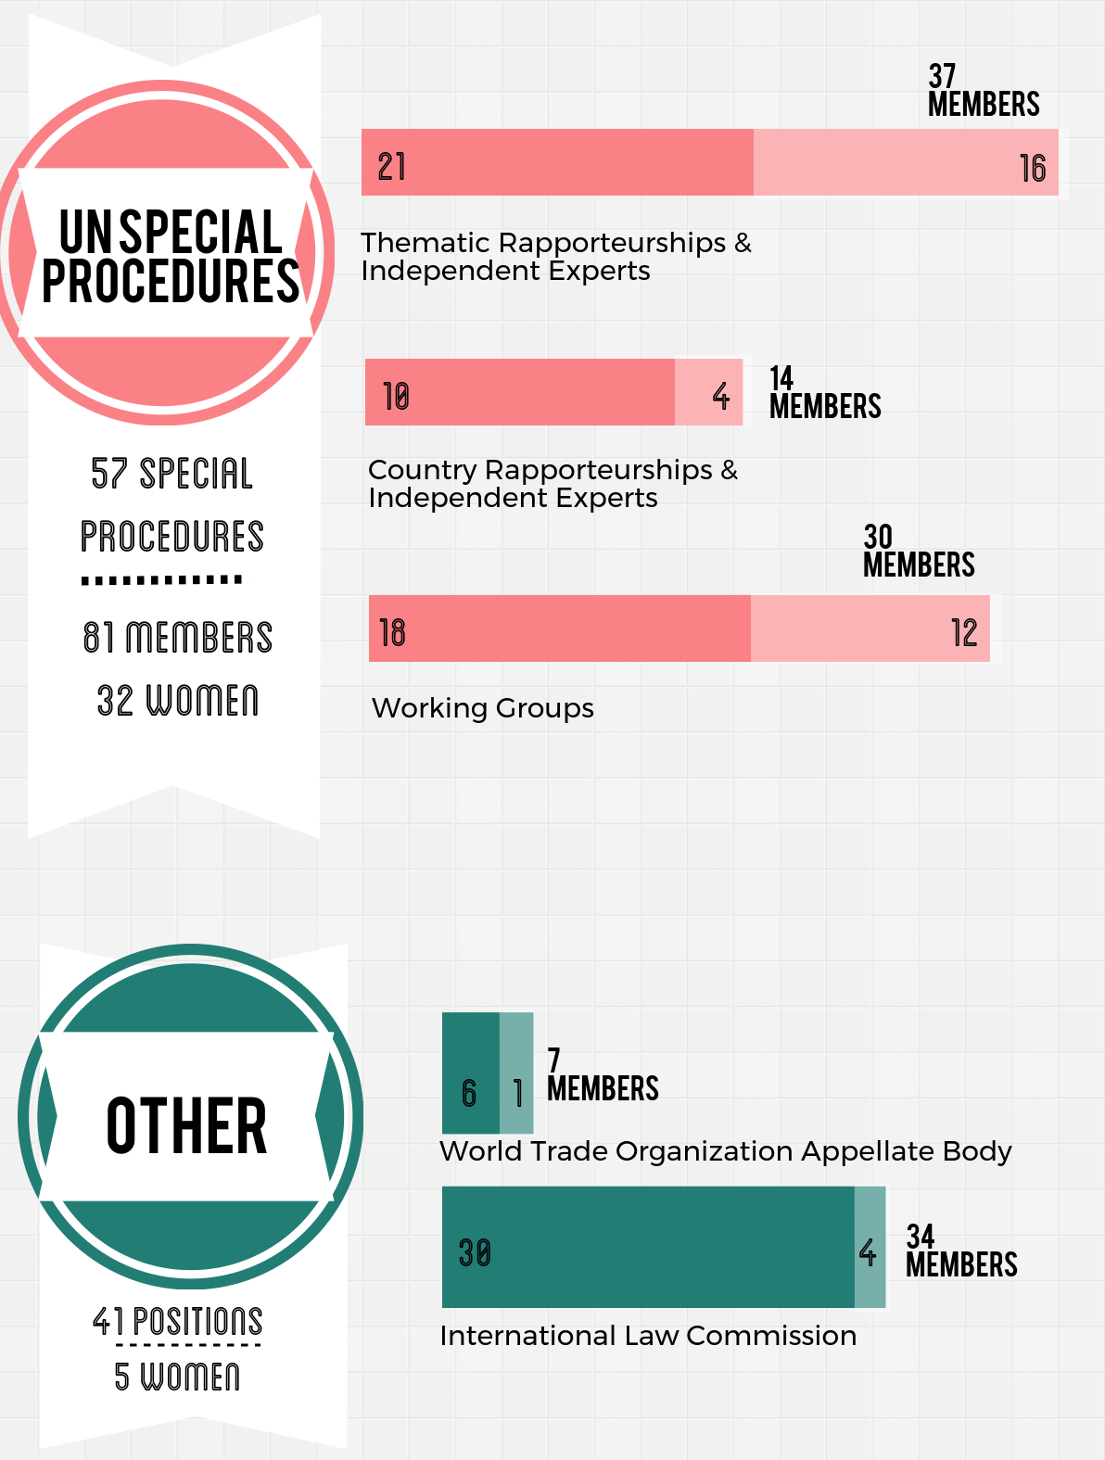

Slide 11

National Data
193 countries in the world
134 have nationals occupying seats in bodies monitored by GQUAL
59 don’t

Slide 12
THE GQUAL RANKING

Slide 13
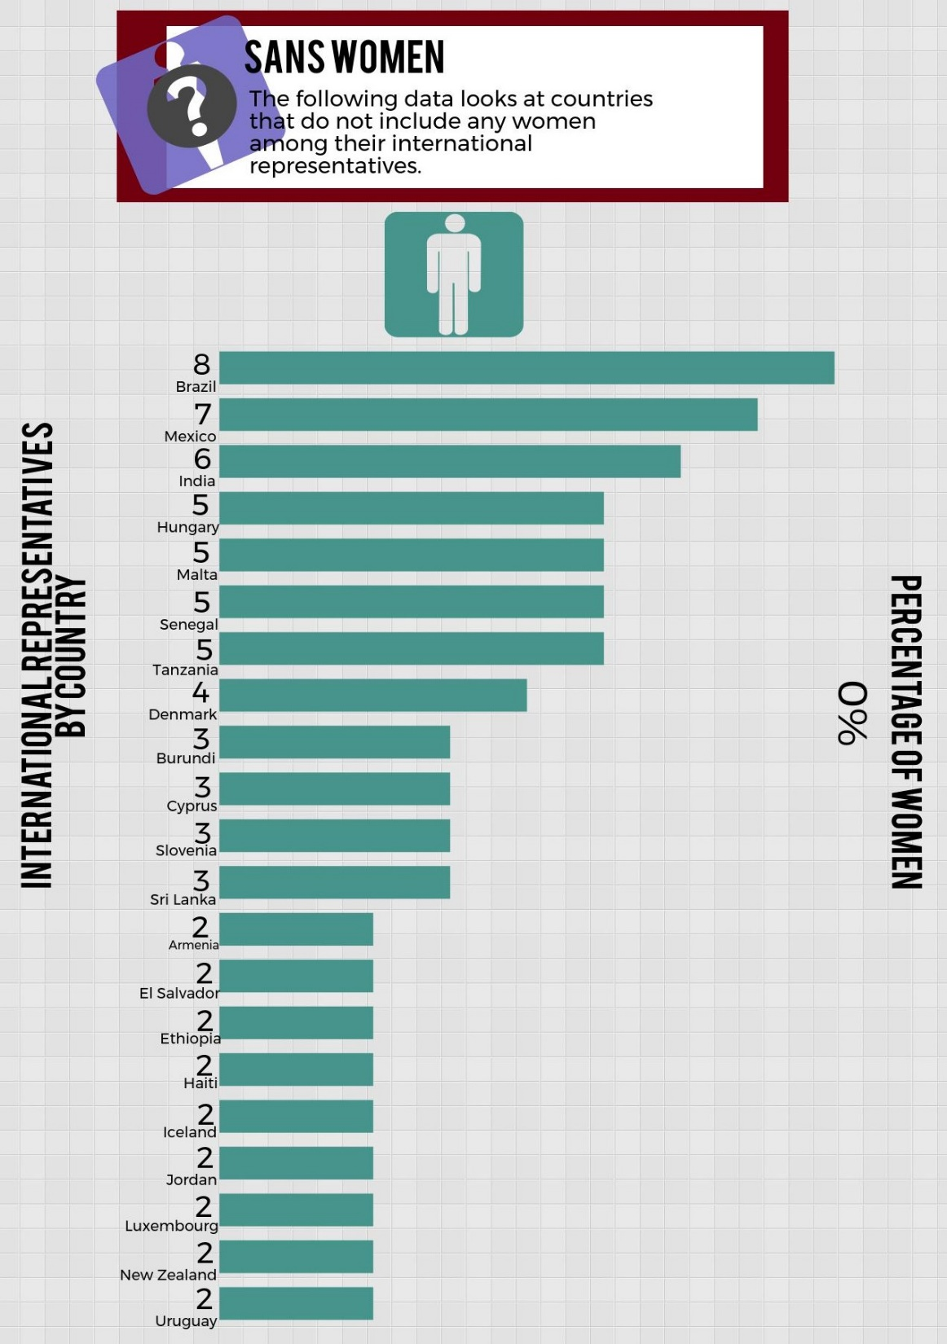

Slide 14
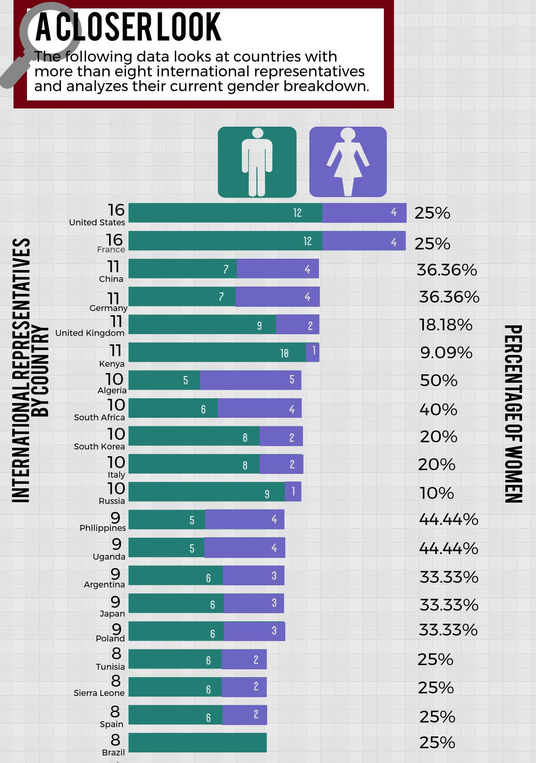

Slide 15
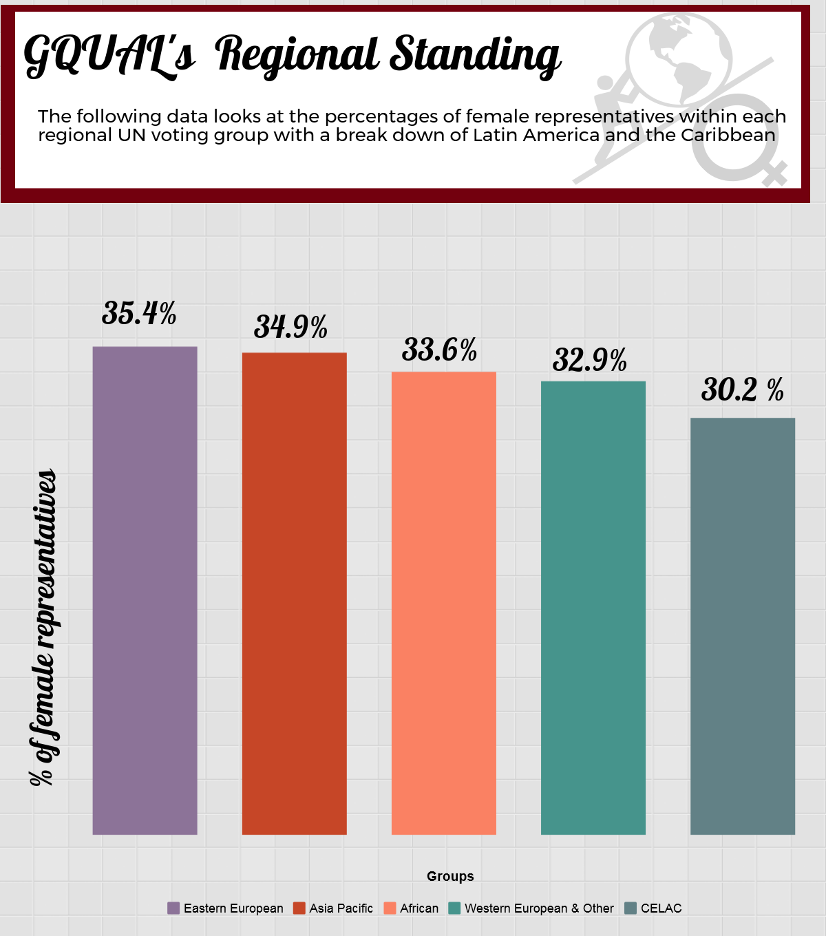
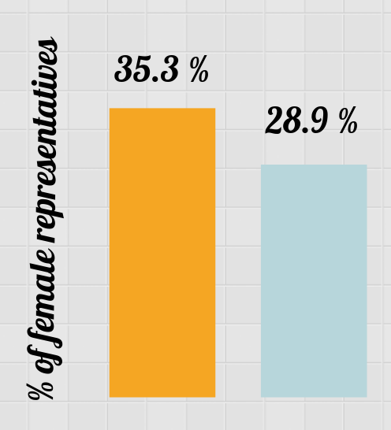
Caribbean
Latin America
Western European & Other
Eastern Europe
Africa
CELAC
Asia Pacific

Slide 16
